Slide 1
EDUC2323 Computer Programming as a Tool for Learning
Workshop 2
People are not Computers
(Computers are not People)

Slide 2
People are not Computers
There are two issues that impact significantly on how we might teach computing as educators and how users interact with technology…
Mental models
Cognitive load

Slide 3
Children and Mental Models
“When you open the door at night why doesn’t the dark come in?”
“What makes the wind blow?”

Slide 4
Constructivism
Knowledge is “constructed” by the learner via their direct personal experience of reality
Our view of external reality is filtered and coloured by several factors
prior knowledge
expectations
emotions
prejudices
There is a knowable universe “out there” however our internal constructed version of it will inevitably fail to map.

Slide 5
Constructivism and Computers
Clear application to programming
Anthropomorphise the computer
Fail to understand how alien it really is

Slide 6
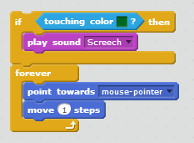
What is the Problem with these Blocks?
An example of debugging
An example of a poor mental model

Slide 7
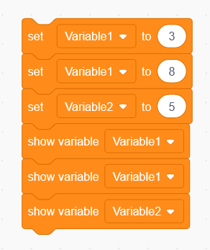
What is the output of these blocks?

Slide 8
How are Mental Models formed and Refined
Partly a function of age, Piaget and the three mountain experiment
Look at the mountains and describe how they look from the other side.
Children between four and six understood the question but could not do what was asked

Slide 9
How are Mental Models formed and Refined
When things go wrong
Accommodation and adaptation
“Why doesn’t the dark come in at night”
Interaction with the external environment is the key

Slide 10
Interaction with
Appropriate problems
Skilled tutor
Social interaction
Scaffolding

Slide 11
So what?
As you learn how to teach programming, you will need to work through your own misconceptions, personal reflection is important
You need to anticipate and identify these misconceptions in your learner’s thinking and support them in building more appropriate mental models
It means that your learners need to be provided with activities that are appropriate to their level of existing knowledge

Slide 12
Seymour Papert - Constructionism
“When teaching the computing curriculum, look wherever you can for practical, creative projects that pupils can work on, perhaps individually, perhaps with a partner, or as part of a small group: this, after all, is how programming and information technology happens in the ‘real world’ and on most university courses. The projects you set are more likely to be motivating if they’re linked to your pupils’ own interests and enthusiasms. These might be to do with other curriculum areas, the life of the school, or their interests beyond school.
Also, look for an audience for pupils’ work, whether they’re presenting to one another, writing for a public blog, creating software or digital content for younger pupils, or planning to upload their work for others to see, via Scratch or a school YouTube account.”
Teaching Section From CAS Primary Guide

Slide 13
Cognitive Load
Short term memory comes with certain limitations suggesting that it has a limited capacity of seven items plus or minus two
Three types of cognitive load
Intrinsic cognitive load - that required for learning a task. For example, if a student needs to understand how Scratch works, they must exert a fixed amount of effort in achieving this understanding
Germaine cognitive load relates the internalisation of learned content, i.e. building the structures in long-term memory
Extraneous cognitive load - generated by the nature of the instructional design, for example a concept “this is Scratch” could be describe to a learner verbally or it might be more easily be demonstrated using a live demo
We want to try and reduce the last one!

Slide 14
In my Experience
Students appear to want…
Clarity in communication of concepts
Clarity of content
Clarity from the tutor
Students don’t want
Out of date content
Access limitations
Rather than explanations students state a preference for direct observation of the code being constructed and used

Slide 15
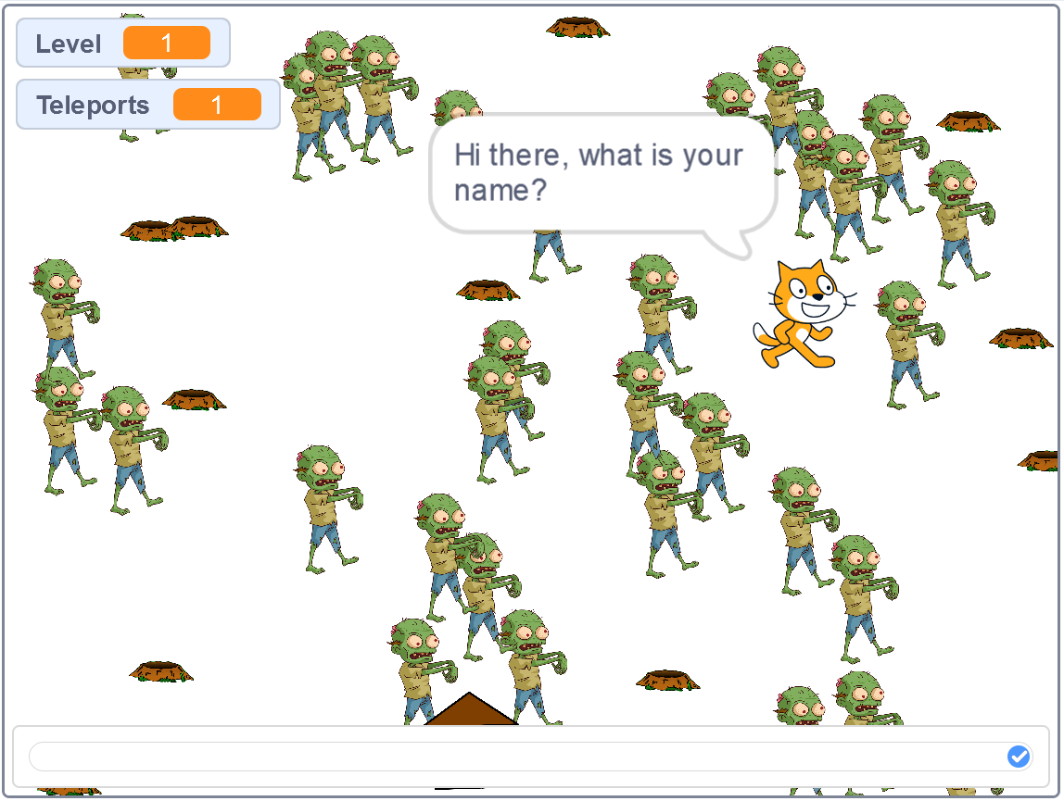
So what?
Too many zombies…

Slide 16
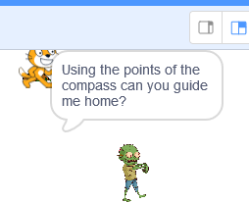
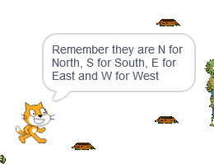
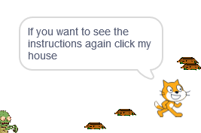
Too much to remember…

Slide 17
Remember
People are not computers
Computers are not people
Reflect on our own incorrect mental models
Try and avoid cognitive load in our system design – also an issue as we teach programming
We may not be the best to judge – ask others to look at our designs

